Slide 1
Fremont River, Part 2
In-Class Task Script
CE En 547
Brigham Young University

Slide 2
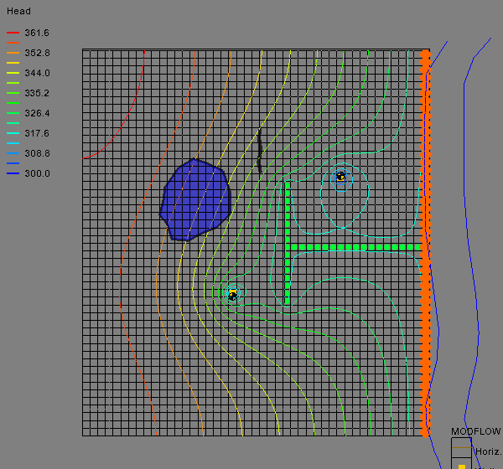
1. Download, unzip, and open file
May want to save as a different name.

Slide 3
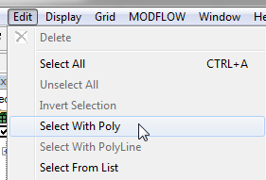
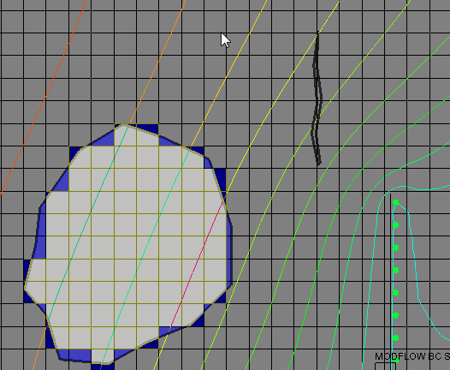
2a. Select cells using polygon
Double-click to close polygon.

Slide 4
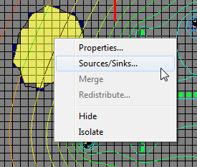
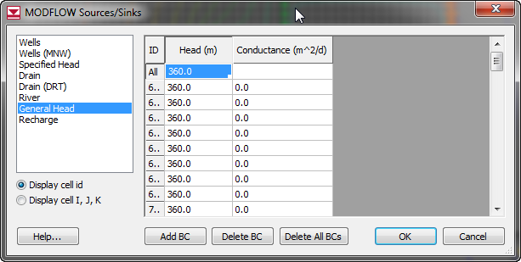
2b. Create GHB cells

Slide 5
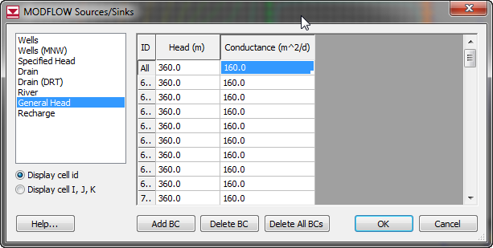
2c. Compute Conductance
C = KA/L
C = (0.2)*(40*40)/2
C = 160

Slide 6
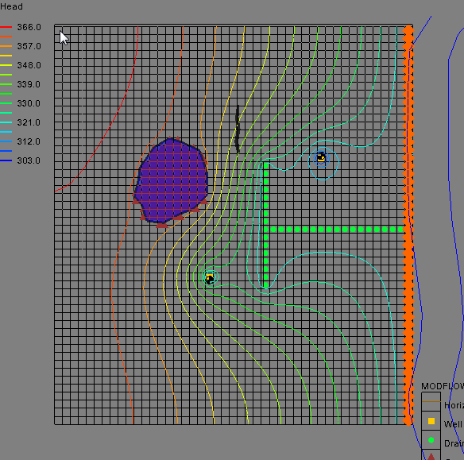
3. Save and Run

Slide 7
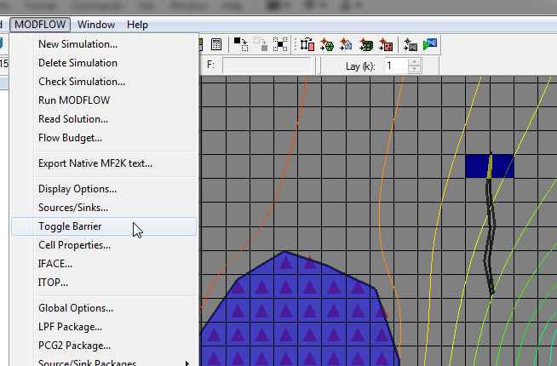
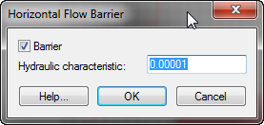
4a-b. Select cells and toggle barrier

Slide 8
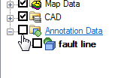
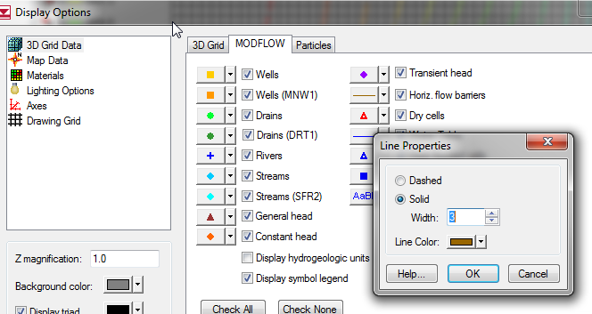
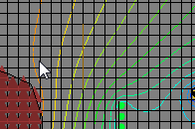
Confirm Barrier
Turn off annotation
May wish to increase HFB symbol thickness
Note brown line

Slide 9
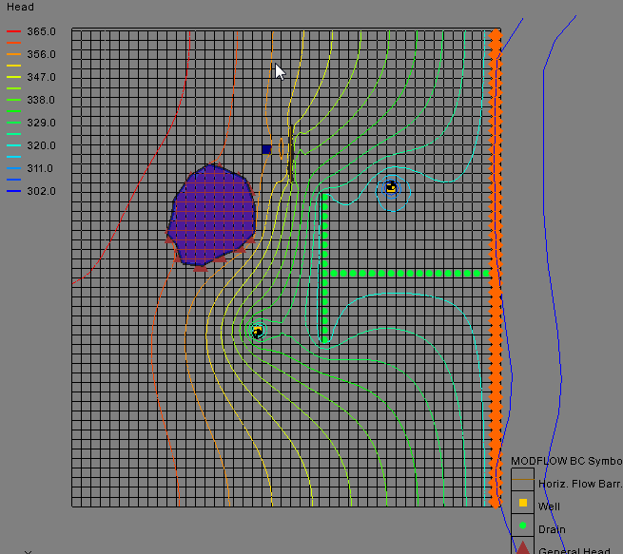
Save and Run

